Slide 1
ECE408 Fall 2016
Applied Parallel Programming
Lecture 18-19: Parallel Sparse Methods

Slide 2
Objective
To learn the key techniques for compacting input data in parallel sparse methods for reduced consumption of memory bandwidth
  better utilization of on-chip memory
  fewer bytes transferred to on-chip memory
  retaining regularity

Slide 3
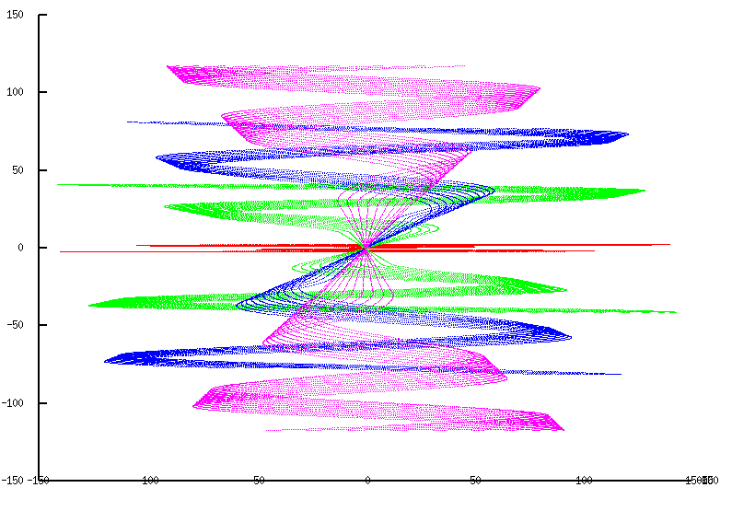
Sparse Data
Motivation for Compaction
Many real-world inputs are sparse/non-uniform
Signal samples, mesh models, transportation networks, communication networks, etc.

Slide 4
Sparse Matrix
Many real-world systems are sparse in nature
  Solving these systems require inversion of the coefficient matrix
  Traditional inversion algorithms such as Gaussian elimination can create too many “fill-in” elements and explode the size of the matrix
  Iterative Conjugate Gradient solvers based on sparse matrix-vector multiplication is preferred
Solution of PDE systems can be formulated into linear operations using sparse matrix-vector multiplication

Slide 5
Science Area | Number of Teams | Codes | Struct Grids | Unstruct Grids | Dense Matrix | Sparse Matrix | N-Body | Monte Carlo | FFT | PIC | Sig I/O
Climate and Weather | 3 | CESM, GCRM, CM1/WRF, HOMME | X | X |  | X |  | X |  |  | X
Plasmas/ Magnetosphere | 2 | H3D(M),VPIC, OSIRIS, Magtail/UPIC | X |  |  |  | X |  | X |  | X
Stellar Atmospheres and Supernovae | 5 | PPM, MAESTRO, CASTRO, SEDONA, ChaNGa, MS-FLUKSS | X |  |  | X | X | X |  | X | X
Cosmology | 2 | Enzo, pGADGET | X |  |  | X | X
Combustion/ Turbulence | 2 | PSDNS, DISTUF | X |  |  |  |  |  | X
General Relativity | 2 | Cactus, Harm3D, LazEV | X |  |  | X
Molecular Dynamics | 4 | AMBER, Gromacs, NAMD, LAMMPS |  |  |  | X | X |  | X
Quantum Chemistry | 2 | SIAL, GAMESS, NWChem |  |  | X | X | X | X |  |  | X
Material Science | 3 | NEMOS, OMEN, GW, QMCPACK |  |  | X | X | X | X
Earthquakes/ Seismology | 2 | AWP-ODC, HERCULES, PLSQR, SPECFEM3D | X | X |  |  | X |  |  |  | X
Quantum Chromo Dynamics | 1 | Chroma, MILC, USQCD | X |  | X | X
Social Networks | 1 | EPISIMDEMICS
Evolution | 1 | Eve
Engineering/System of Systems | 1 | GRIPS,Revisit |  |  |  |  |  | X
Computer Science | 1 |  |  | X | X | X |  |  | X |  | X

Slide 6
Sparse Matrix-Vector Multiplication (SpMV)
×
+
A
X
Y
Y

Slide 7
Challenges
Compared to dense matrix multiplication, SpMV
  Is irregular/unstructured
  Has little input data reuse
  Benefits little from compiler transformation tools
Key to maximal performance
  Maximize regularity (by reducing divergence and load imbalance)
  Maximize DRAM burst utilization (layout arrangement)

Slide 8
A Simple Parallel SpMV
Row 0 | 3 | 0 | 1 | 0 | Thread 0
Row 1 | 0 | 0 | 0 | 0 | Thread 1
Row 2 | 0 | 2 | 4 | 1 | Thread 2
Row 3 | 1 | 0 | 0 | 1 | Thread 3
Each thread processes one row

Slide 9
Compressed Sparse Row (CSR) Format
 |  |  | Row 0 |  |  | Row 2 |  |  |  | Row 3
Nonzero values | data[7] | { | 3, | 1, |  | 2, | 4, | 1, |  | 1, | 1 | }
Column indices | col_index[7] | { | 0, | 2, |  | 1, | 2, | 3, |  | 0, | 3 | }
Row Pointers | ptr[5] | { | 0, 2, 2, 5, 7 }

Slide 10
CSR Data Layout
row_ptr
0
2
2
5
7
data
3
1
2
4
1
1
1
col_index
0
2
1
2
3
0
3

Slide 11
CSR Kernel Design
ptr
CSR Format

Slide 12
A Parallel SpMV/CSR Kernel (CUDA)
__global__ void SpMV_CSR(int num_rows, float *data,
int *col_index, int *row_ptr, float *x, float *y) {
2. int row = blockIdx.x * blockDim.x + threadIdx.x;
3. if (row < num_rows) {
4. float dot = 0;
5. int row_start = row_ptr[row];
6. int row_end = row_ptr[row+1];
7. for (int elem = row_start; elem < row_end; elem++) {
8. dot += data[elem] * x[col_index[elem]];
}
9. y[row] = dot;
}
}
 |  |  | Row 0 |  |  | Row 2 |  |  |  | Row 3
Nonzero values | data[7] | { | 3, | 1, |  | 2, | 4, | 1, |  | 1, | 1 | }
Column indices | col_index[7] | { | 0, | 2, |  | 1, | 2, | 3, |  | 0, | 3 | }
Row Pointers | row_ptr[5] | { | 0, 2, 2, 5, 7 }

Slide 13
CSR Kernel Control Divergence
Threads execute different number of iterations in the kernel for-loop
row_ptr
0
2
2
5
7
data
3
1
2
4
1
1
1
col_index
0
2
1
2
3
0
3

Slide 14
CSR Kernel Memory Divergence
Adjacent threads access non-adjacent memory locations
  Grey elements are accessed by all threads in iteration 0
row_ptr
0
2
2
5
7
data
3
1
2
4
1
1
1
col_index
0
2
1
2
3
0
3

Slide 15
Regularizing SpMV with ELL(PACK) Format
3
1
*
Thread 0
Thread 1
Thread 2
Thread 3
*
*
*
3
*
2
1
2
4
1
1
*
4
1
1
1
*
*
*
1
*
CSR with Padding
Transposed
Pad all rows to the same length
  Inefficient if a few rows are much longer than others
Transpose (Column Major) for DRAM efficiency
Both data and col_index padded/transposed

Slide 16
ELL Kernel Design
A
ELL Format

Slide 17
A parallel SpMV/ELL kernel
__global__ void SpMV_ELL(int num_rows, float *data,
int *col_index, int num_elem, float *x, float *y) {
2. int row = blockIdx.x * blockDim.x + threadIdx.x;
3. if (row < num_rows) {
4. float dot = 0;
5. for (int i = 0; i < num_elem; i++) {
6. dot += data[row+i*num_rows]*x[col_index[row+i*num_rows]];
}
7. y[row] = dot;
}
}

Slide 18
Memory Coalescing with ELL
3
*
2
1
Thread 0
1
*
4
1
Thread 1
Thread 2
Thread 3
*
*
1
*
data
3
*
2
1
1
*
4
1
*
*
1
0
*
1
0
2
*
2
3
*
*
3
col_index

Slide 19
Coordinate (COO) format
Explicitly list the column and row indices for every non-zero element
 |  |  | Row 0 |  |  | Row 2 |  |  |  | Row 3
Nonzero values | data[7] | { | 3, | 1, |  | 2, | 4, | 1, |  | 1, | 1 | }
Column indices | col_index[7] | { | 0, | 2, |  | 1, | 2, | 3, |  | 0, | 3 | }
Row indices | row_index[7] | { | 0, | 0, |  | 2, | 2, | 2, |  | 3, | 3 | }

Slide 20
COO Allows Reordering of Elements
 |  |  | Row 0 |  |  | Row 2 |  |  |  | Row 3
Nonzero values | data[7] | { | 3, | 1, |  | 2, | 4, | 1, |  | 1, | 1 | }
Column indices | col_index[7] | { | 0, | 2, |  | 1, | 2, | 3, |  | 0, | 3 | }
Row indices | row_index[7] | { | 0, | 0, |  | 2, | 2, | 2, |  | 3, | 3 | }
Nonzero values | data[7] | { | 1 | 1, | 2, | 4, | 3, | 1 | 1 | }
Column indices | col_index[7] | { | 0 | 2, | 1, | 2, | 0, | 3, | 3 | }
Row indices | row_index[7] | { | 3 | 0, | 2, | 2, | 0, | 2, | 3 | }

Slide 21
1. for (int i = 0; i < num_elem; row++)
2. y[row_index[i]] += data[i] * x[col_index[i]];
a sequential loop that implements SpMV/COO

Slide 22
COO Kernel Design
Accessing Input Matrix and Vector
x
v
Ax = v
All threads can access matrix and row_idenx, each using the accessed col_index to access vector
Maximal parallelism..
Row
Col
Data
A
COO Storage Format

Slide 23
COO kernel Design
Accumulating into Output Vector
x
v
Ax = v
Each threads uses the row_index of its element to accumulate into one of the output Y elements
Need atomic operations!
Row
Col
Data
A

Slide 24
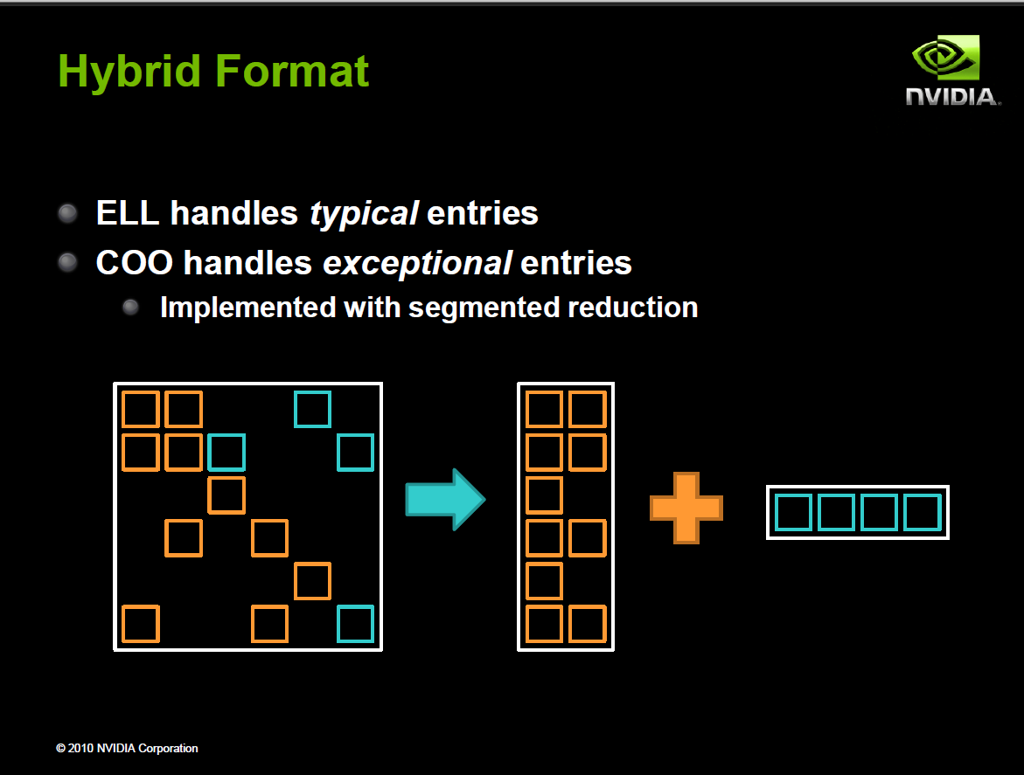
Often implemented in sequential host code in practice

Slide 25
Reduced Padding with Hybrid Format
 |  | data |  |  | col_index
Thread 0 |  | 3 | 1 |  | 0 | 2
Thread 1 |  | * | * |  | * | *
Thread 2 |  | 2 | 4 |  | 1 | 2
Thread 3 |  | 1 | 1 |  | 0 | 3
Thread 0
Thread 1
Thread 2
Thread 3
Iteration 0
data
3
*
2
1
1
*
4
1
data
1
col_index
3
index
0
*
1
0
2
*
2
3
row_index
2
ELL
COO

Slide 26
JDS (Jagged Diagonal Sparse) Kernel Design for Load Balancing
Perm with
jds_row_index
Access with
col_index
Sort rows into descending order according to number of non-zero. Keep track of the original row numbers so that the output vector can be generated correctly.
JDS Format

Slide 27
Sorting Rows According to Length (Regularization)
3
1
2
4
1
Row 2
3
1
Row 0
2
4
1
1
1
Row 3
1
1
Row 1
CSR
JDS

Slide 28
CSR to JDS Conversion
 |  |  | Row 0 |  |  | Row 2 |  |  |  | Row 3
Nonzero values | data[7] | { | 3, | 1, |  | 2, | 4, | 1, |  | 1, | 1 | }
Column indices | col_index[7] | { | 0, | 2, |  | 1, | 2, | 3, |  | 0, | 3 | }
Row Pointers | row_ptr[5] | { | 0, 2, 2, 5, 7 }
 |  |  | Row 2 |  | Row 0 |  |  |  |  | Row 3
Nonzero values | data[7] | { | 2, | 4, | 1, |  | 3, | 1, |  | 1 | 1 | }
Column indices | col_index[7] | { | 1, | 2, | 3, |  | 0, | 2, |  | 0, | 3 | }
JDS Row Pointers | jds_row_ptr[5] | { | 0, 3, 5, 7,7 }
JDS Row Indices | jds_row_index | { | 2, 0, 3, 1 }

Slide 29
JDS Summary
Nonzero values | data[7] | { 2, 4, 1, 3, 1, 1, 1 }
Column indices | col_index[7] | { 1, 2, 3, 0, 2, 0, 3 }
JDS row indices | Jds_row_index[4] | { 2, 0, 3, 1 }
JDS Row Ptrs | Jds_row_ptr[4] | { 0, 3, 5, 7, 7 }
2
4
1
3
1
1
1
1
2
3
0
0
2
3

Slide 30
A Parallel SpMV/JDS Kernel
__global__ void SpMV_JDS(int num_rows, float *data,
  int *col_index, int *jds_row_ptr,int jds_row_index,
  float *x, float *y) {
2. int row = blockIdx.x * blockDim.x + threadIdx.x;
3. if (row < num_rows) {
4. float dot = 0;
5. int row_start = jds_row_ptr[row];
6. int row_end = jds_row_ptr[row+1];
7. for (int elem = row_start; elem < row_end; elem++) {
8. dot += data[elem] * x[col_index[elem]];
}
9. y[jds_row_index[row]] = dot;
}
}
 |  |  | Row 2 |  | Row 0 |  |  |  |  | Row 3
Nonzero values | data[7] | { | 2, | 4, | 1, |  | 3, | 1, |  | 1 | 1 | }
Column indices | col_index[7] | { | 1, | 2, | 3, |  | 0, | 2, |  | 0, | 3 | }
JDS Row Pointers | jds_row_ptr[5] | { | 0, 3, 5, 7,7 }
JDS Row Indices | jds_row_index | { | 2, 0, 3, 1 }

Slide 31
JDS vs. CSR - Control Divergence
Threads still execute different number of iterations in the JDS kernel for-loop
  However, neighboring threads tend to execute similar number of iterations because of sorting.
  Better thread utilization
Nonzero values | data[7] | { 2, 4, 1, 3, 1, 1, 1 }
Column indices | col_index[7] | { 1, 2, 3, 0, 2, 0, 3 }
JDS row indices | Jds_row_index[4] | { 2, 0, 3, 1 }
JDS Row Ptrs | Jds_row_ptr[4] | { 0, 3, 5, 7, 7 }
data
2
4
1
3
1
1
1
col_index
1
2
3
0
0
2
3

Slide 32
JDS vs. CSR Memory Divergence
Adjacent threads still access non-adjacent memory locations
Nonzero values | data[7] | { 2, 4, 1, 3, 1, 1, 1 }
Column indices | col_index[7] | { 1, 2, 3, 0, 2, 0, 3 }
JDS row indices | jds_row_index[4] | { 2, 0, 3, 1 }
JDS Row Ptrs | jds_row_ptr[4] | { 0, 3, 5, 7, 7 }
data
2
4
1
3
1
1
1
col_index
1
2
3
0
0
2
3

Slide 33
JDS with Trasposition
jds_col_ptr
Access with col_index
Perm with jds_row_index

Slide 34
Transposition for Memory Coalescing
2
4
1
2
3
1
Row 2
3
1
4
1
1
Row 0
1
1
1
Row 3
Row 1
JDS
JDS-transposed

Slide 35
JDS Format with Transposed Layout
Row 0 | 3 | 0 | 1 | 0 | Thread 0
Row 1 | 0 | 0 | 0 | 0 | Thread 1
Row 2 | 0 | 2 | 4 | 1 | Thread 2
Row 3 | 1 | 0 | 0 | 1 | Thread 3
JDS row indices | jds_row_index[4] | { 2, 0, 3, 1 }
JDS column pointers | jds_t_col_ptr[4] | { 0, 3, 6, 7 }
data
2
3
1
4
1
1
1
2
3
1
col_index
1
0
2
2
0
3
3
4
1
1
1

Slide 36
JDS with Transposition
Memory Coalescing
2
3
1
Thread 0
4
1
1
Thread 1
Thread 2
Thread 3
1
data
2
3
1
4
1
1
1
1
0
2
2
0
3
3
col_index

Slide 37
JDS with Transposition
Memory Coalescing
2
3
1
Thread 0
4
1
1
Thread 1
Thread 2
Thread 3
1
data
2
3
1
4
1
1
1
Not aligned with DRAM bursts but OK with recent GPUS
1
0
2
2
0
3
3
col_index

Slide 38
JDS with Transposition
Memory Coalescing
2
3
1
Thread 0
4
1
1
Thread 1
Thread 2
Thread 3
1
data
2
3
1
4
1
1
1
1
0
2
2
0
3
3
col_index

Slide 39
A Parallel SpMV/JDS_T Kernel
__global__ void SpMV_JDS_T(int num_rows, float *data,
  int *col_index, int *jds_t_col_ptr, int *jds_row_index,
  float *x, float *y) {
2. int row = blockIdx.x * blockDim.x + threadIdx.x;
3. if (row < num_rows) {
float dot = 0;
    unsigned in sec = 0;
5. while (jds_t_col_ptr[sec+1]-jds_t_col_ptr[sec] > row){
dot += data[jds_t_col_ptr[sec]+row] * x[col_index[jds_t_col_ptr[sec]+row]];
sec++;
}
8. y[jds_row_index[row]] = dot;
}
}
 |  |  | Sec 0 |  | Sec 1 |  |  |  |  | Sec 2
Nonzero values | data[7] | { | 2, | 3, | 1, |  | 4, | 1, |  | 1 | 1 | }
Column indices | col_index[7] | { | 1, | 0, | 3, |  | 2, | 2, |  | 3, | 3 | }
JDS_T Column Pointers | jds_t_col_ptr[5] | { | 0, 3, 5, 7,7 }
JDS Row Indices | jds_row_index[4] | { | 2, 0, 3, 1 }

